Slide 1
Session 3 – Map Reduce

Slide 2
Pre - requisites
Complete Unit 3.0
Faculty Video Lecture
Self Assessment Quiz Complete
Problem Solving Complete

Slide 3
Session Content (Map Reduce)
Queries on Unit 3.0
Distributed Computing – Traditional Approach
Hadoop Approach - Map Reduce
Word Count Examples Explained
Word Count Variations & Other Examples
Hadoop Combiners
Hadoop Partitioners

Slide 4

Queries on Unit 3.0

Slide 5
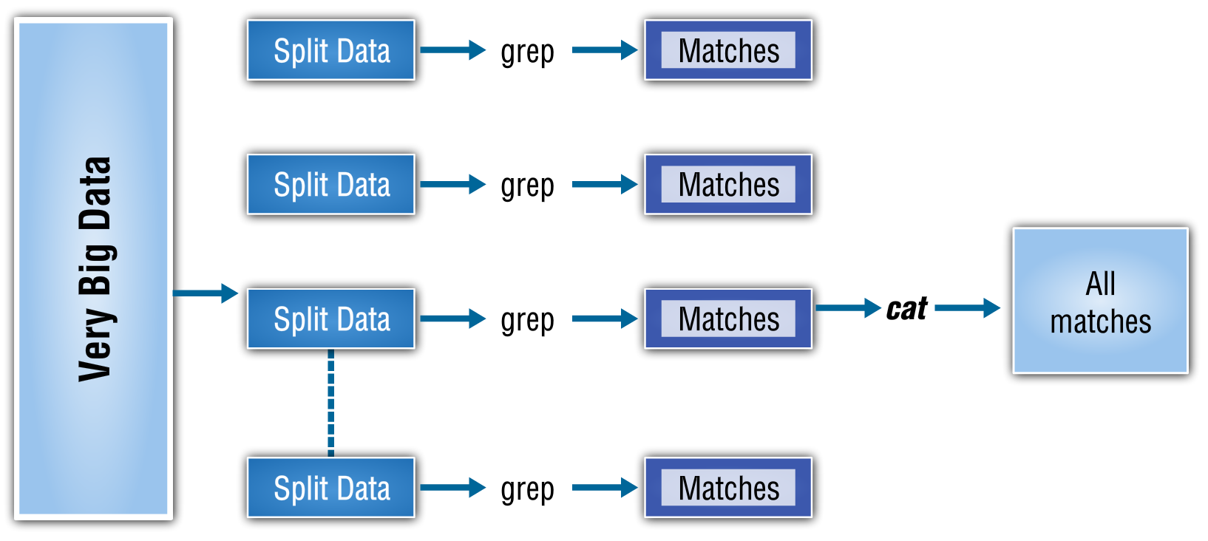
Distributed Computing– Traditional Way

Slide 6
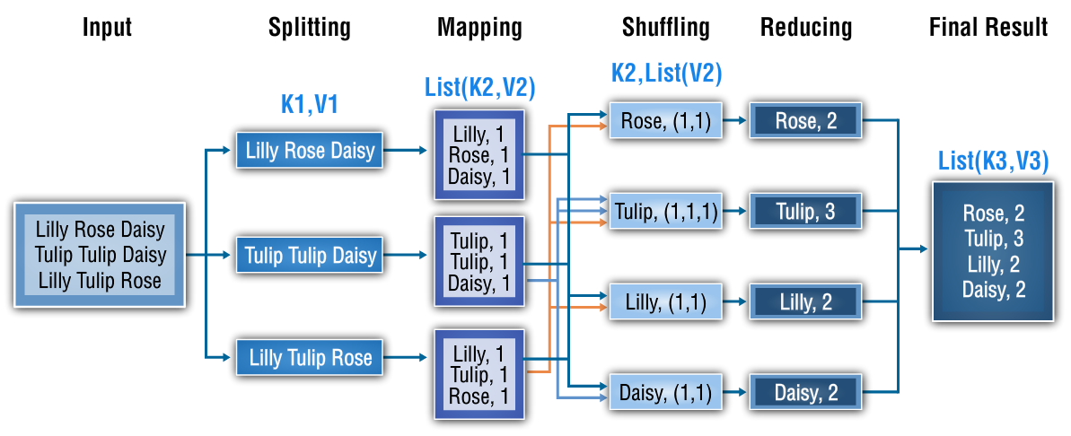
Hadoop Approach (Map Reduce)

Slide 7
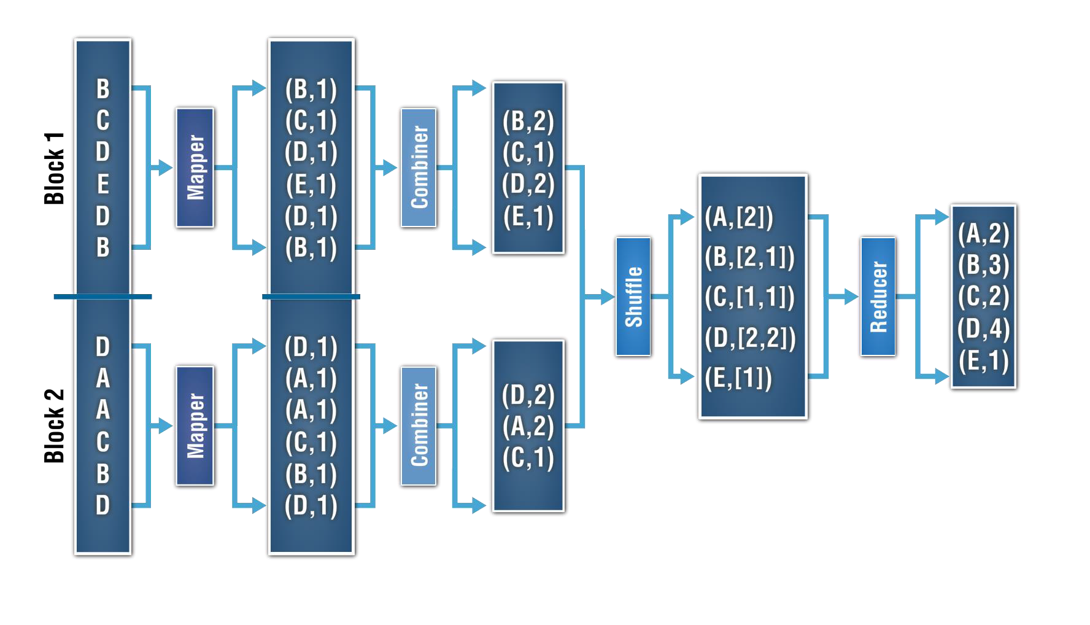
Hadoop Combiners

Slide 8
Hadoop Partitioners
Partitioner looks up the key generated by mappers
It finds the ASCII value of the key
Partitioner now does a hash modulo over ASCII Value to decide which key is to be sent to which reducer.
It now creates the partitions at the mapper machines to be sent to different reducers. It then starts sending these partitions to the respective reducer machines using the shuffling process.
Each of these reducer machines will receive the partitions from other mapper machines as well.
Stage is now set for the sort at reducer machine after the merge. Similar keys are arrange in a single key value pairs.
These pairs are now fed into the reducer.

Slide 9
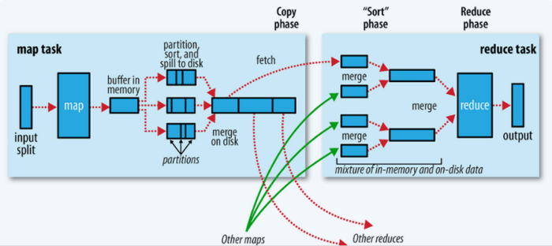
Shuffle Operation

Slide 10
Queries on Unit 3.0

